Slide 1

DRAIP: Your AI Travel Companion
Intelligent Itinerary Planning Powered by Artificial Intelligence
Personalized travel plans that adapt to your mood, preferences, and real-time conditions
By MA group
February 28, 2026
1

Slide 2







Travel Planning is Overwhelming
Traditional planning leaves travelers frustrated before their journey even begins
Hours of Research
Generic Recommendations
Juggling Google Maps, Weather.com, Booking.com, and TripAdvisor creates chaos.
One-size-fits-all itineraries ignore your unique interests and energy levels.
App Fragmentation
Rigid Schedules
Switching between multiple apps disrupts flow and increases decision fatigue.
Fixed plans break down when weather changes or energy levels shift.
Budget Surprises
The average traveler spends 8+ hours planning a single trip across 12+ different websites and apps.
Hidden costs accumulate without real-time tracking, causing financial stress.
2

Slide 3


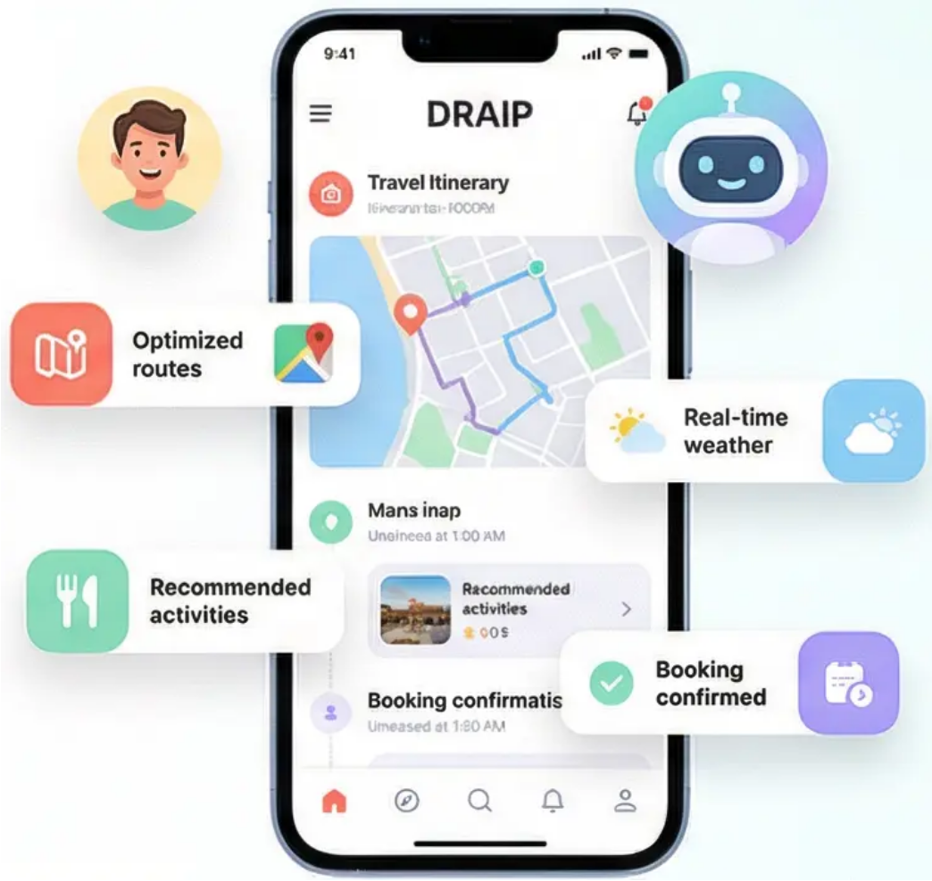




Meet DRAIP – Your Intelligent Travel Companion
One app that understands you, your mood, and your destination
Personalized itineraries that adapt in real-time
Traditional Planning: Overwhelming & Fragmented
DRAIP: Unified & Intelligent
Mood-Aware - Adapts to how you feel
All-in-One - Maps, weather, recommendations unified
Real-Time AI - Learns and adjusts instantly
3

Slide 4






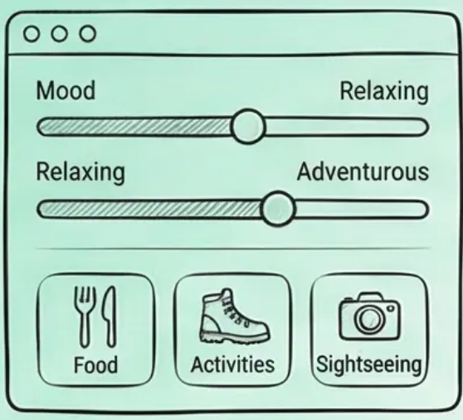



Intelligent Planning in 4 Simple Steps
From destination to personalized journey in minutes
🗺️ Set Destination
👤 Define Your Style
🤖 AI Generation
📱 Real-Time Adaptation
Choose your dream
destination
Set mood, preferences
& lifestyle
AI creates personalized
itinerary
Plans adapt to your mood
& environement
Complete setup in under 2 minutes
4

Slide 5




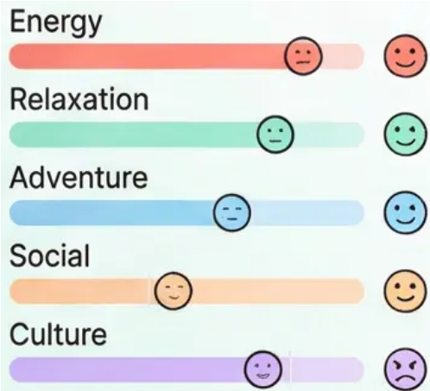
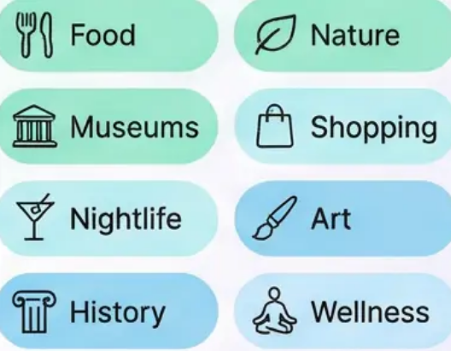

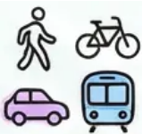
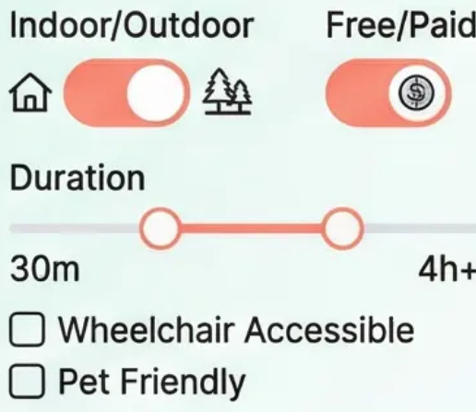
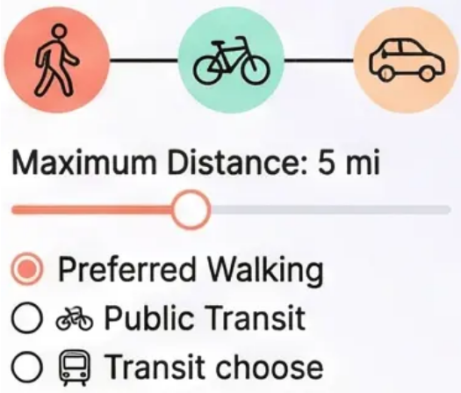
The App Knows You
Smart profiling that understands your unique travel personality
Mood Sliders
Smart Preferences
Express your current state across five dimensions: Energy, Relaxation, Adventure, Social, and Culture
Fine-tune across eight categories: Food, Nature, Museums, Shopping, Nightlife, Art, History, and Wellness
Example Profile: High Energy + Food Lover + Walking Preferred
Activity Filters
Smart Transport
Street food tour with 2-hour walking route
Customize by Indoor/Outdoor, Free/Paid, Duration, and personal constraints
Choose Walking, Biking, Public Transit, or Car with distance preferences
5

Slide 6


Your Personal AI Travel Agent
Intelligent analysis of your preferences creates perfectly tailored travel experiences
🧠 Multi-Dimensional Analysis Processes 15+ preference factors including mood, energy, interests, and constraints.
🌤️ Real-Time Weather Intelligence Integrates live weather data to automatically adapt outdoor/indoor activities.
276 tokens per second inference speed with Grok's Llama 3.3 70B model enables real-time planning and natural conversations
📍 Global Location Database Leverages OpenStreetMap's 50,000+ places worldwide with zero API costs.
💰 Smart Budget Optimization Allocates spending across meals, transport, and activities with real-time tracking.
⏰ Perfect Time Sequencing Minimizes travel time between locations while maximizing experience quality.
6

Slide 7

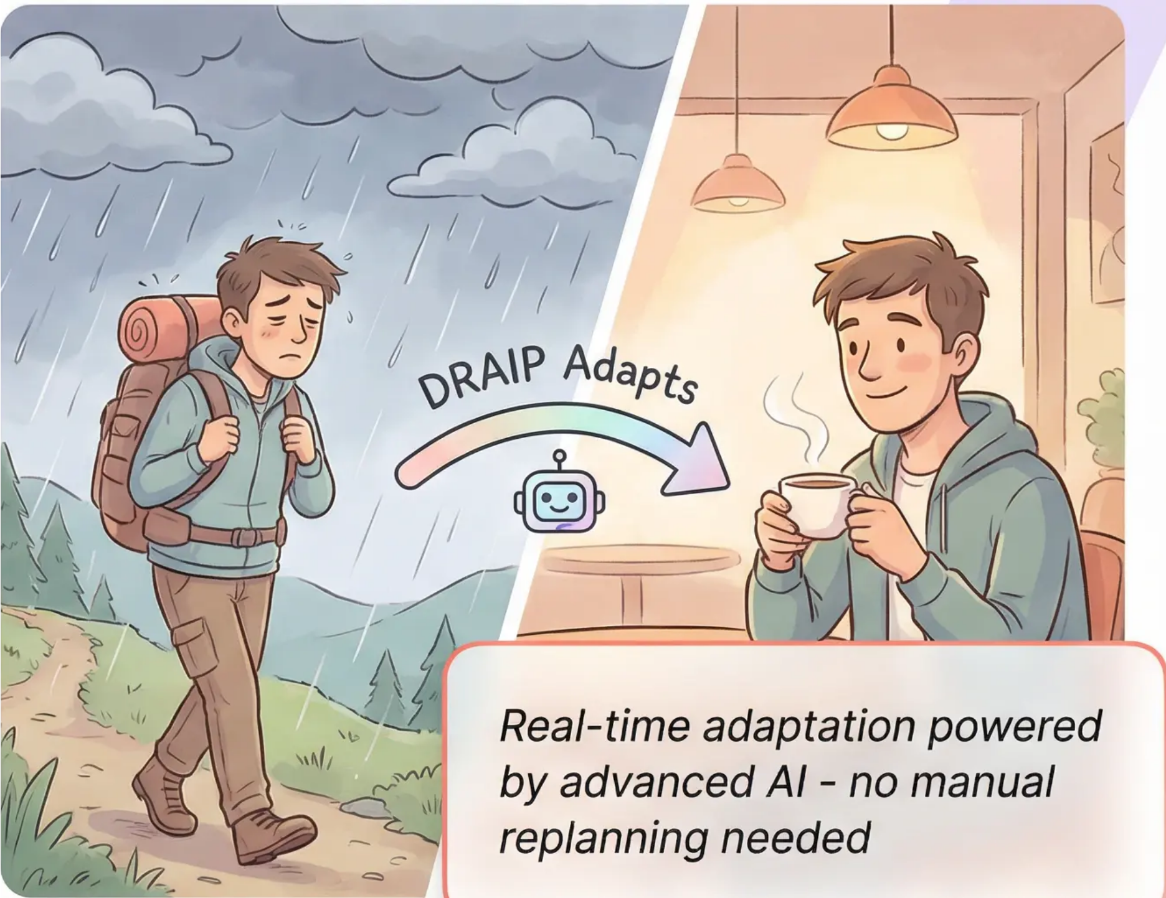




Plans That Flex With You
Your itinerary adapts in real-time to keep your journey perfect
Feeling Tired?
AI suggests cozy cafés and quiet parks for instant relaxation
Getting Bored?
Discovers exciting local events and interactive experiences nearby
Weather Changes?
Seamlessly shifts outdoor plans to engaging indoor alternatives
Running Late?
Intelligently resequences activities to optimize your remaining time
7

Slide 8






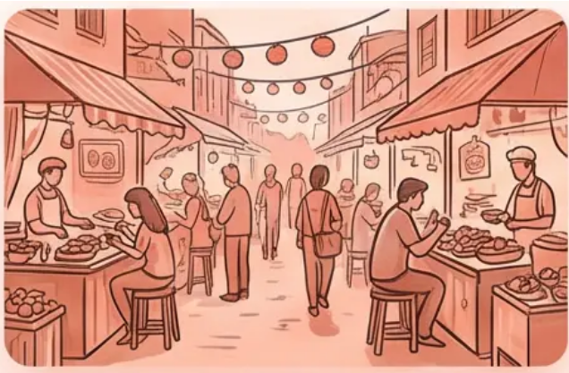


Discover Hidden Gems
Powered by Groq AI for Ultra-Fast, Context-Aware Recommendations
276 tokens/second inference speed • Llama 3.3 70B model
Perfect Matches
Authentic Flavors
Picture Perfect
Mind & Body
AI analyzes your mood, preferences, and context to find spots that feel like they were made for you
Discover off-the-beaten- path restaurants and local specialties that match your taste preferences
Find photogenic locations optimized for lighting, crowds, and your aesthetic preferences
Curated mindfulness walks, yoga sessions, and spa visits matched to your energy level
Rooftop Café
Hidden Tapas Bar
Golden Hour Bridge
Riverside Yoga
• Relaxation Match: 94%
• Food Match: 98%
• Photo Score: 96%
• Wellness Match: 92%
• Crowd Level: Low
• Local Favorite
• Best Time: 6:30 PM
• Duration: 45 min
8

Slide 9

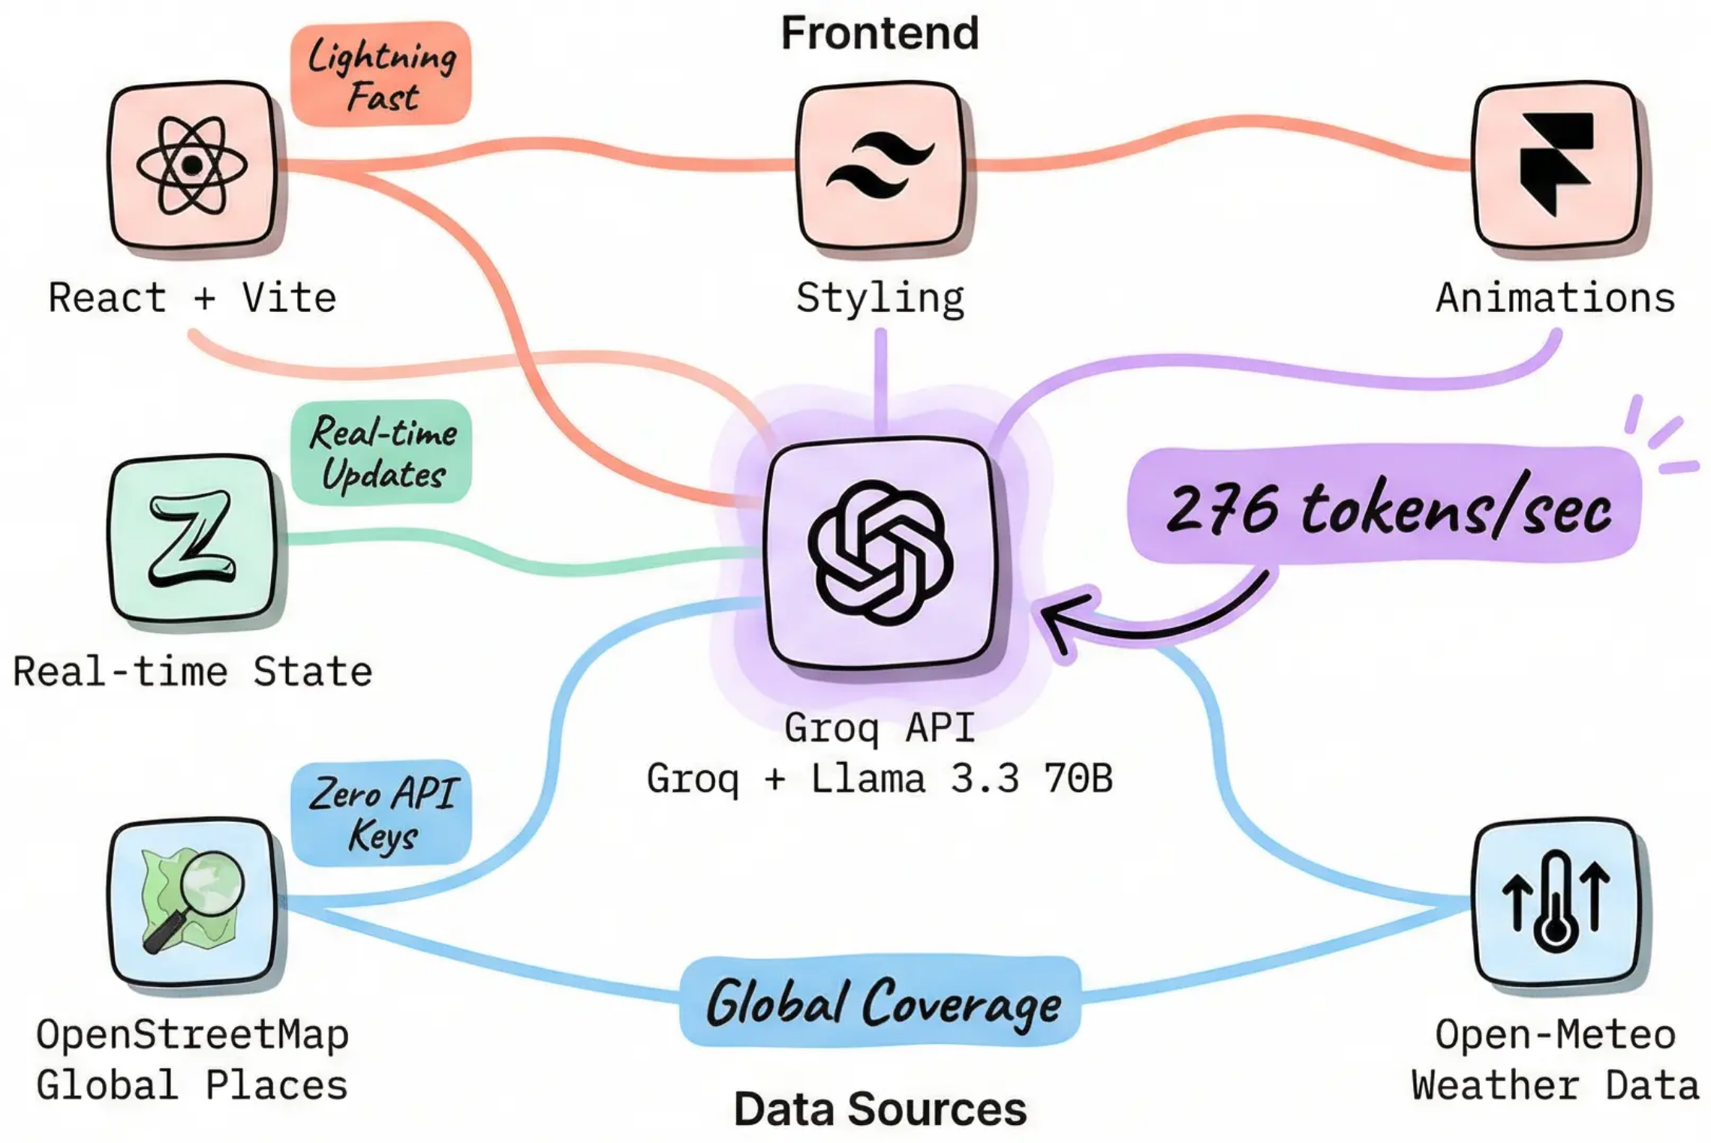
Built With Modern Technology
A high-performance stack designed for speed, intelligence, and global reach
9

Slide 10

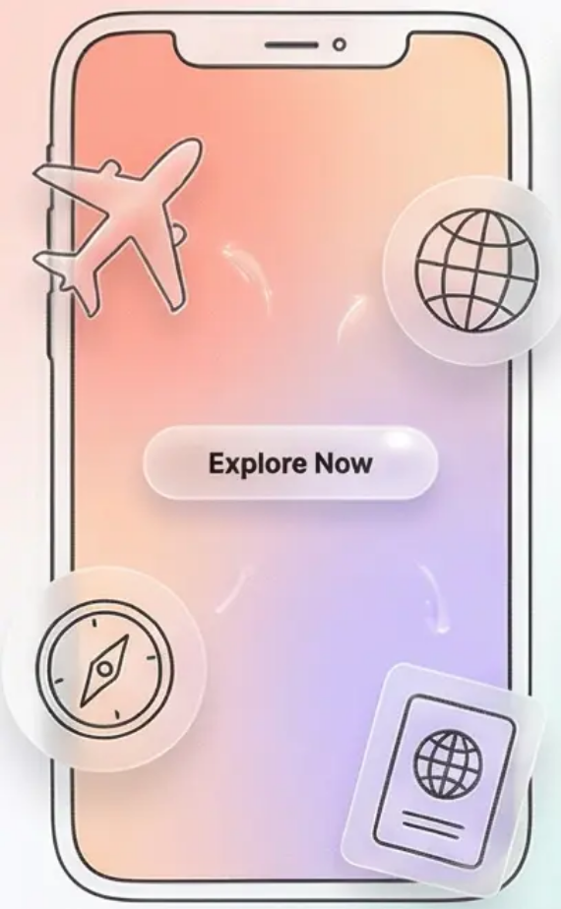
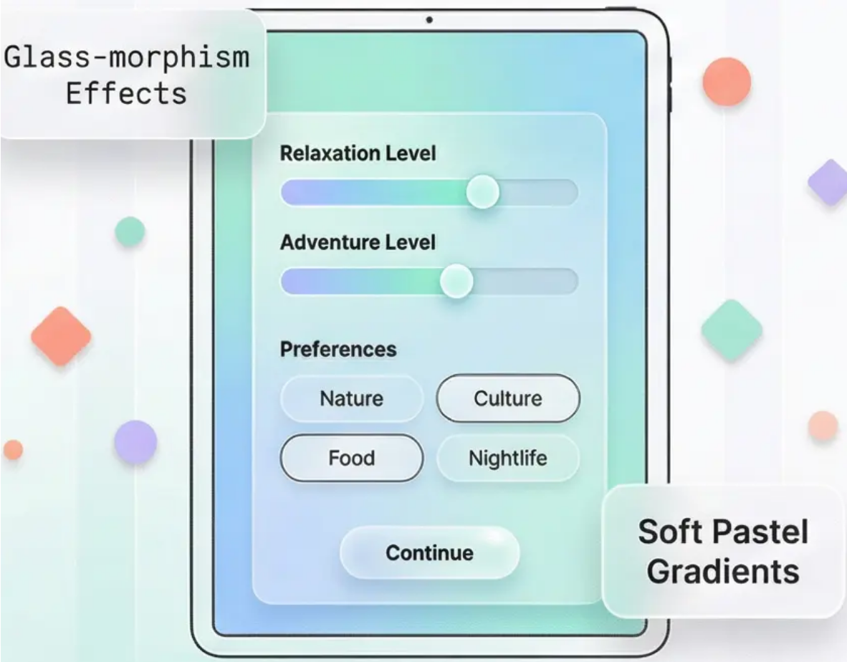
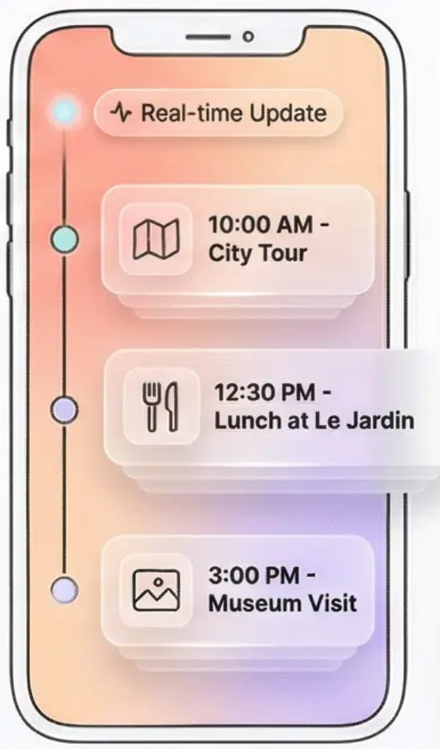
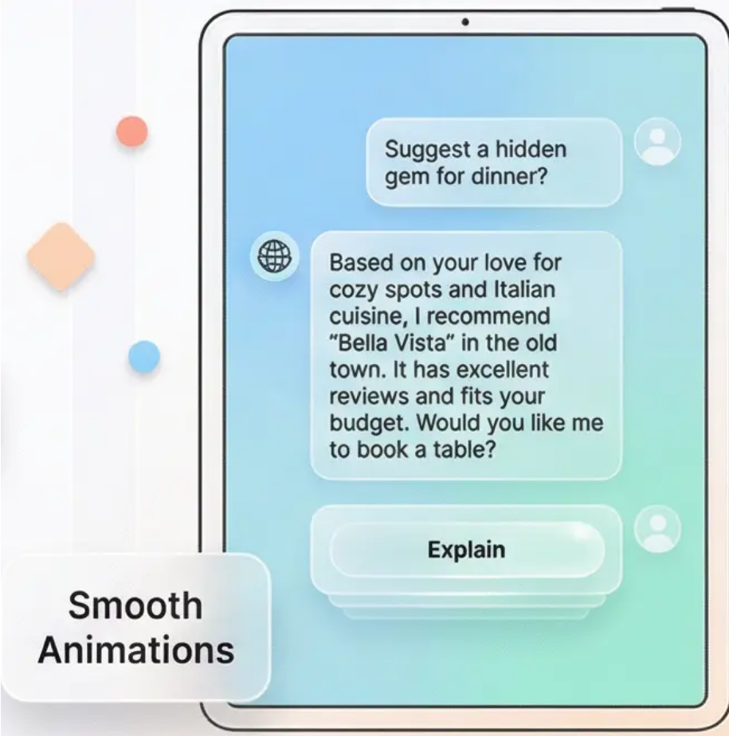
Beautiful, Intuitive Design
Glass-morphism UI that feels alive and responsive
Welcome Screen
Smart Setup
Live Itinerary
AI Companion
Dreamy animations with floating travel icons
Interactive mood sliders and preference selection
Floating cards with real-time updates
Transparent chat with explainable decisions
Welcome Screen
Smart Setup
Live Itinerary
AI Companion
Dreamy animations with floating travel icons
Interactive mood sliders and preference selection
Floating cards with real-time updates
Transparent chat with explainable decisions
10

Slide 11


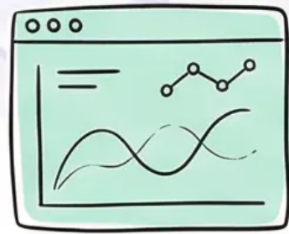

Transparent AI Decisions
Building Trust Through AI Transparency
Complete Decision Log
Real-Time Learning Metrics
Natural Language Explanations
Every recommendation tracked with reasoning: “Selected Café X because you prefer quiet, free spots with 92% relaxation match”
Cumulative reward tracking and satisfaction trends help optimize future recommendations
“This museum recommended because you enjoy culture (89% match) and it's 10 minutes from your hotel”
No Black Box Decisions - Every suggestion includes clear reasoning
11

Slide 12

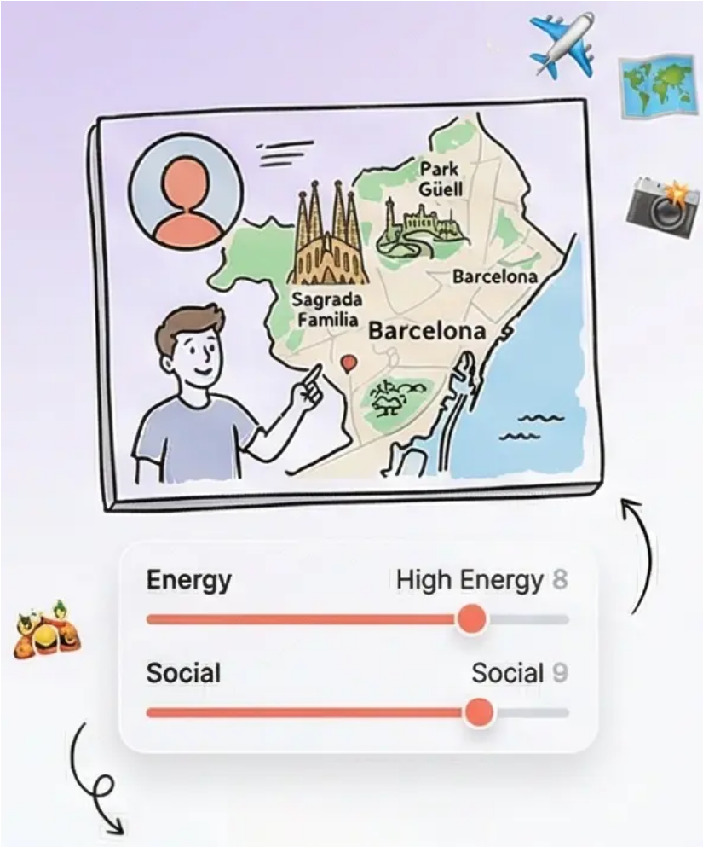
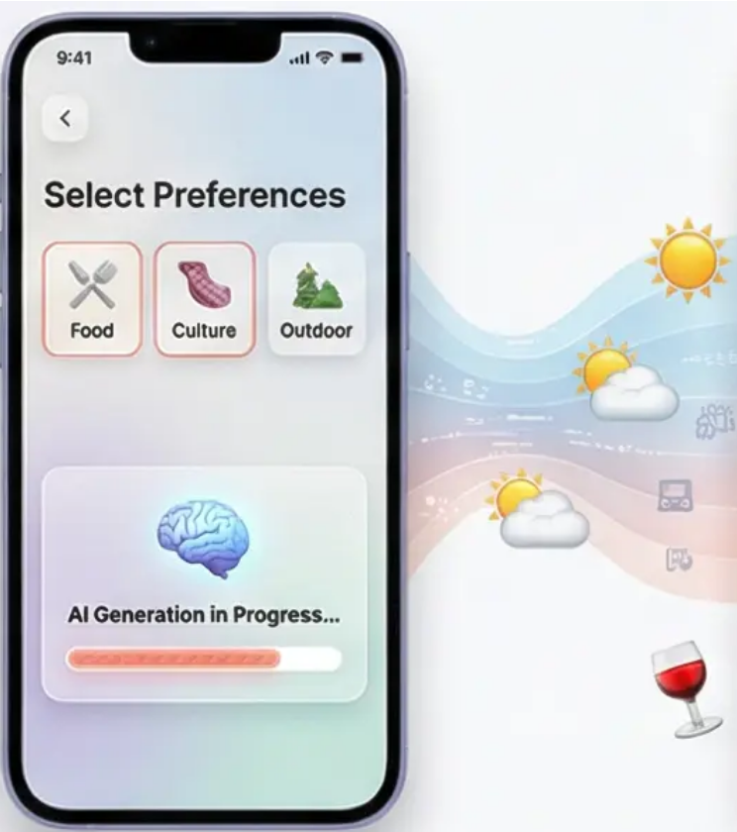
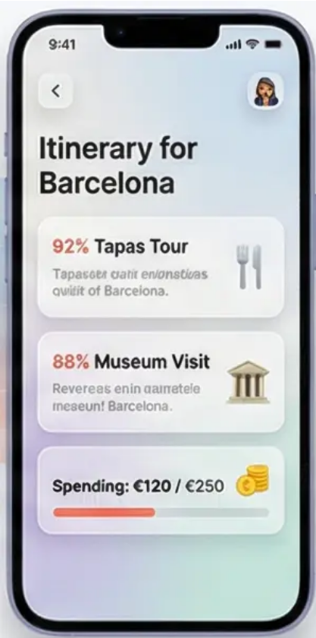
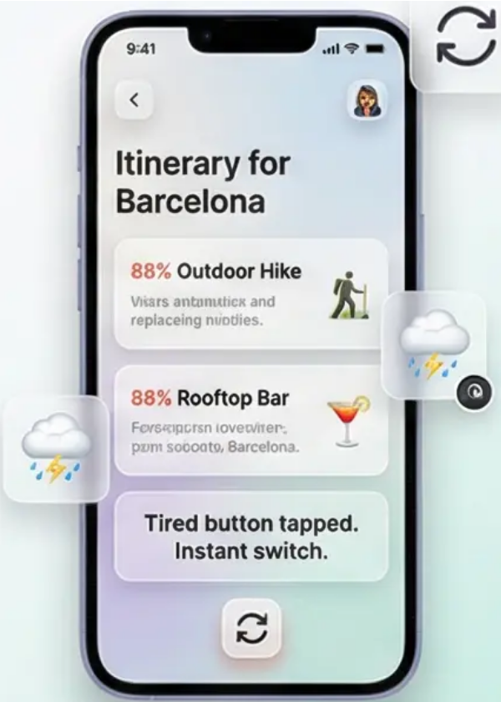

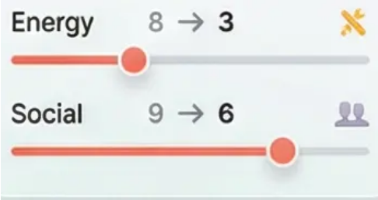

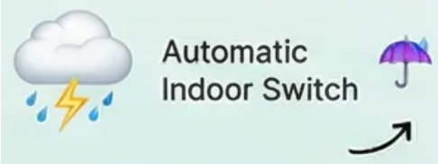
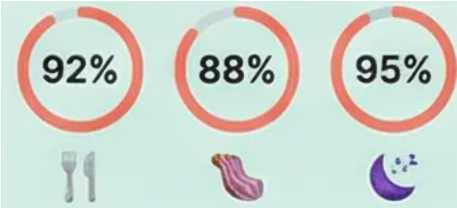
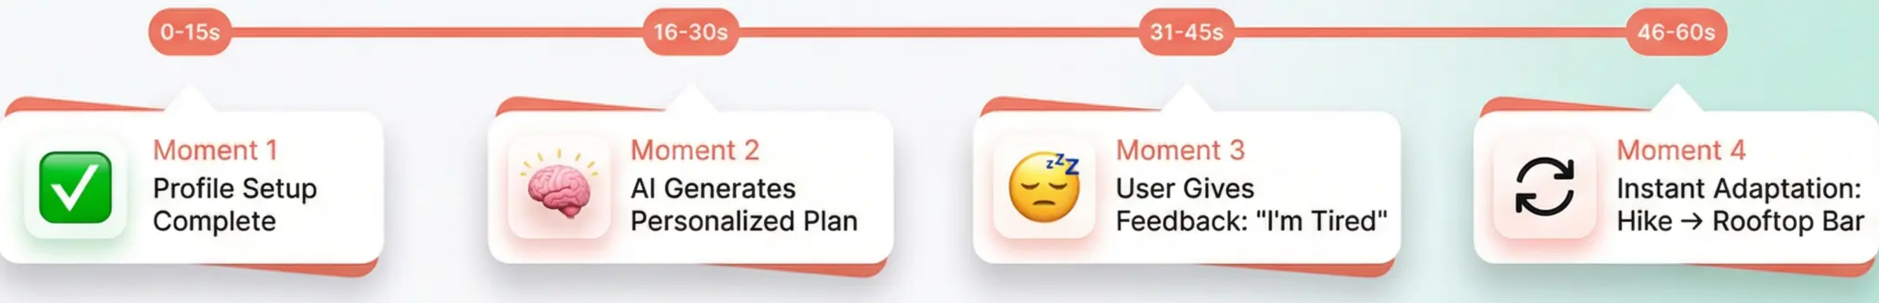
See It In Action
60-Second Demo: Barcelona Adventure
Mood Sliders in Action
Weather Trigger
Match Scores
Profile Setup Complete
AI Generates Personalized Plan
User Gives Feedback: "I'm Tired"
Instant Adaptation: Hike → Rooftop Bar
Try It Live!
For instant demo access
12

Slide 13

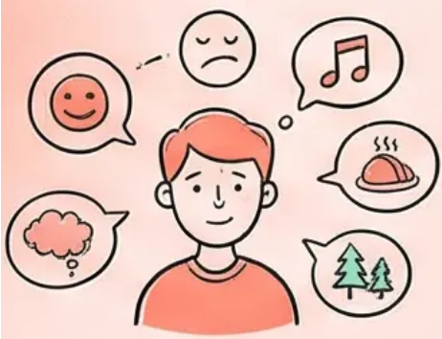




Why Choose DRAIP
Five game-changing benefits that transform your travel experience
100% Personalized
Saves Hours
Budget Smart
Adapts to your mood, energy, and unique travel style in real-time
Complete itinerary generated in seconds, not days of research
Real-time spending alerts prevent budget surprises
Global Coverage
Completely Free
Works anywhere with 50,000+ locations worldwide
Core features require no API keys or hidden costs
13

Slide 14


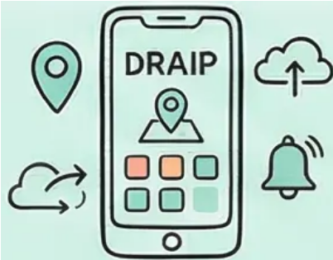

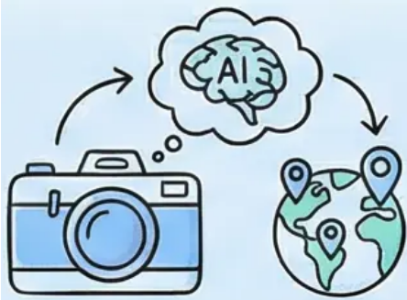

What's Next For DRAIP
Expanding Your Travel Experience
Group Planning
Native Mobile App
Collaborative trip planning with consensus-building tools for families and friends
iOS & Android app with offline functionality and push notifications
Voice Interface
Natural language interaction - just say what you need
Photo-Based Discovery
Direct Booking
Upload a photo you love - find similar places worldwide
One-click reservations through integrated travel platforms
14

Slide 15






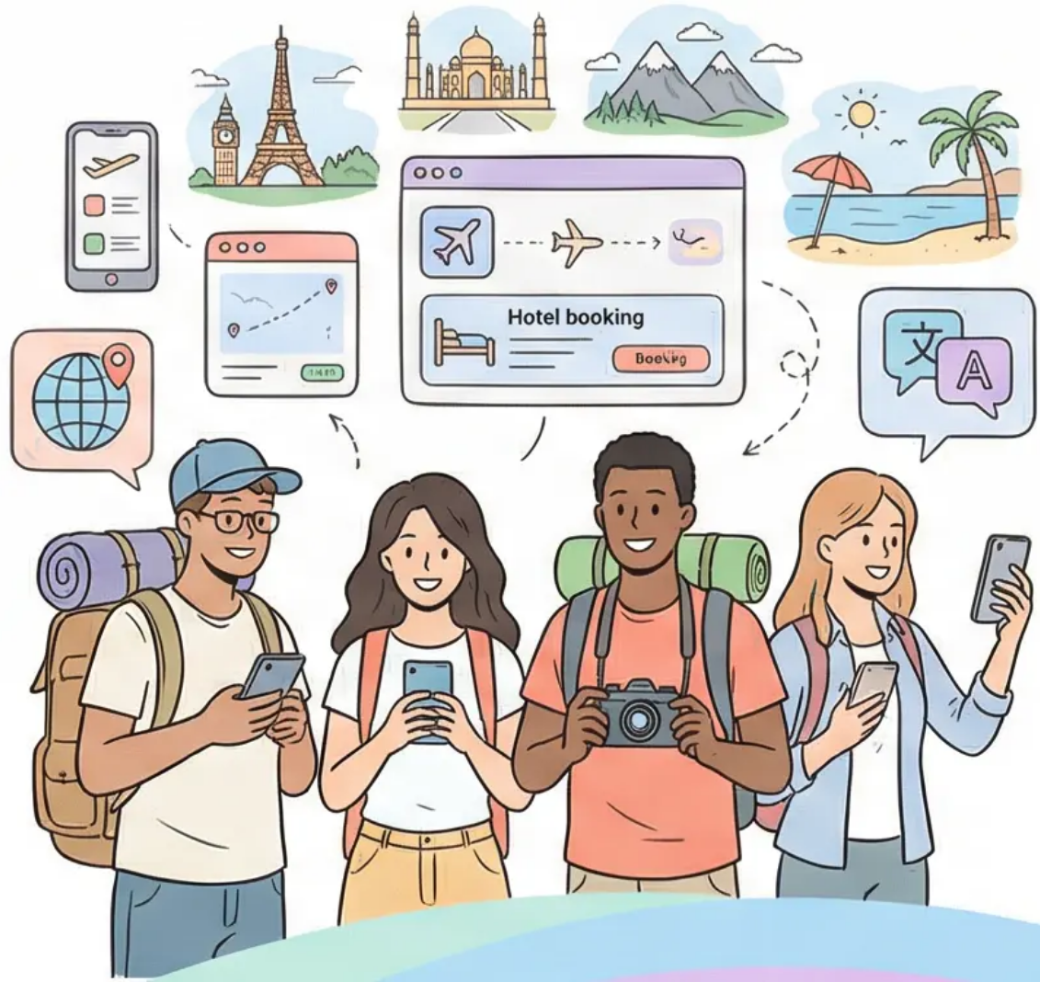
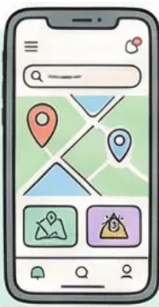



Ready for Smarter Travel?
Join the DRAIP Community Today
Try Live Demo
Explore on GitHub
Get in Touch
Experience DRAIP in action
Dive into the open-source code
MA@ainc .tn
Share your travel dreams with us!
www.draip.ai
15

